Slide 1
VDR 1
Team 520
John Baumann, Natalie Boggess, Cody Carlson, Megan Jadush, Malik Jean-Baptiste, Anders Snell
10/15/2024

Slide 2



Natalie Boggess
Introduction – Project Mentors
Sponsor:
Dr. Rassweiler
Manager:
Dr. McConomy
Advisor:
Dr. Clark

Slide 3



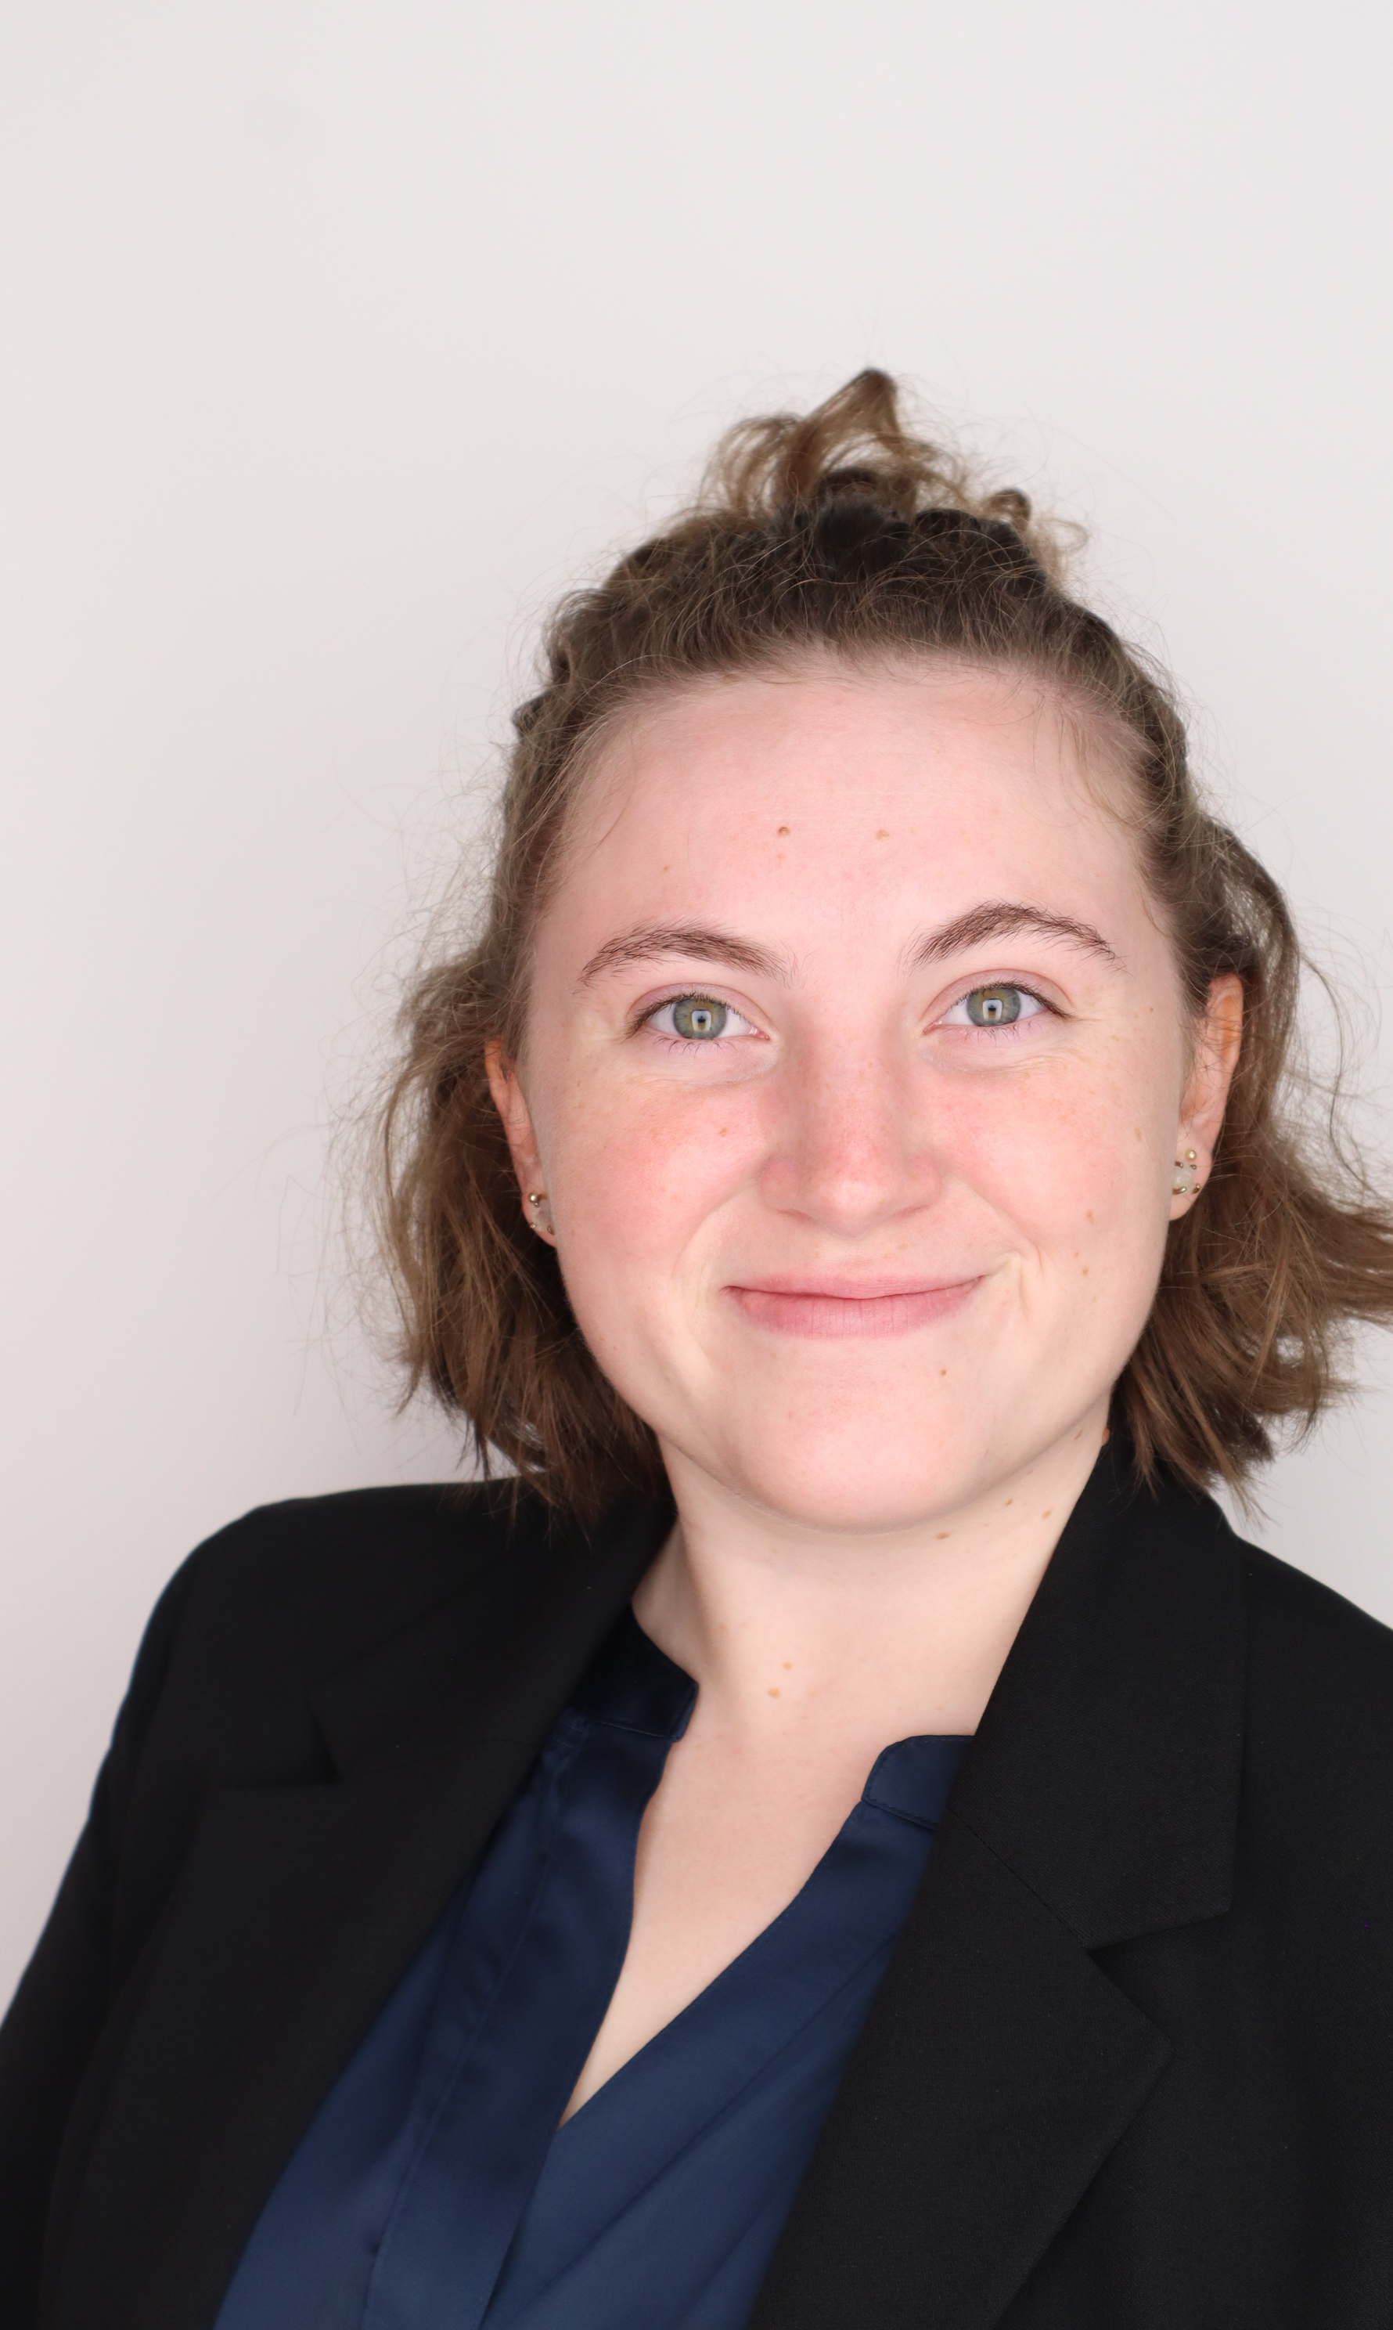
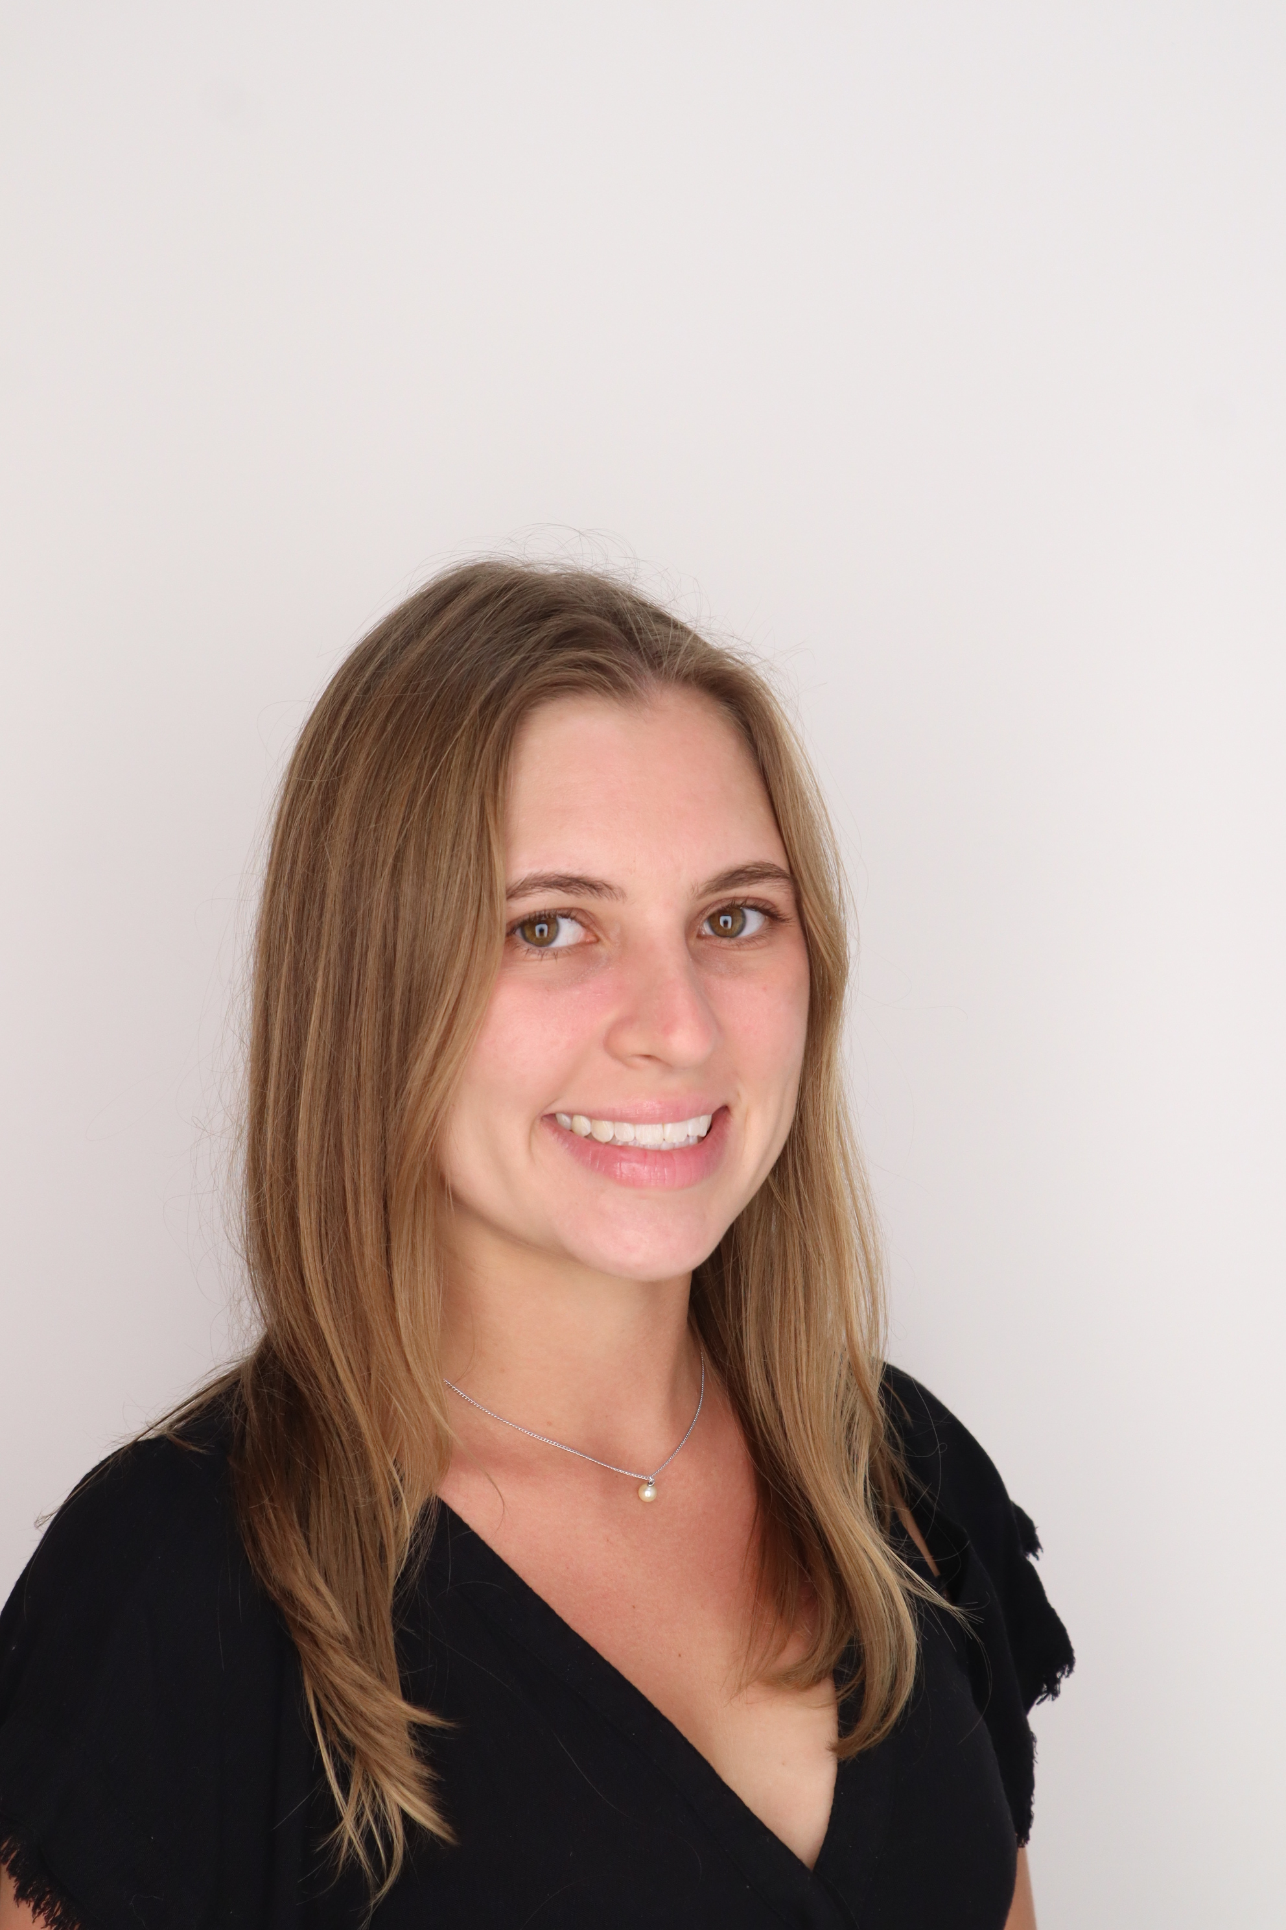
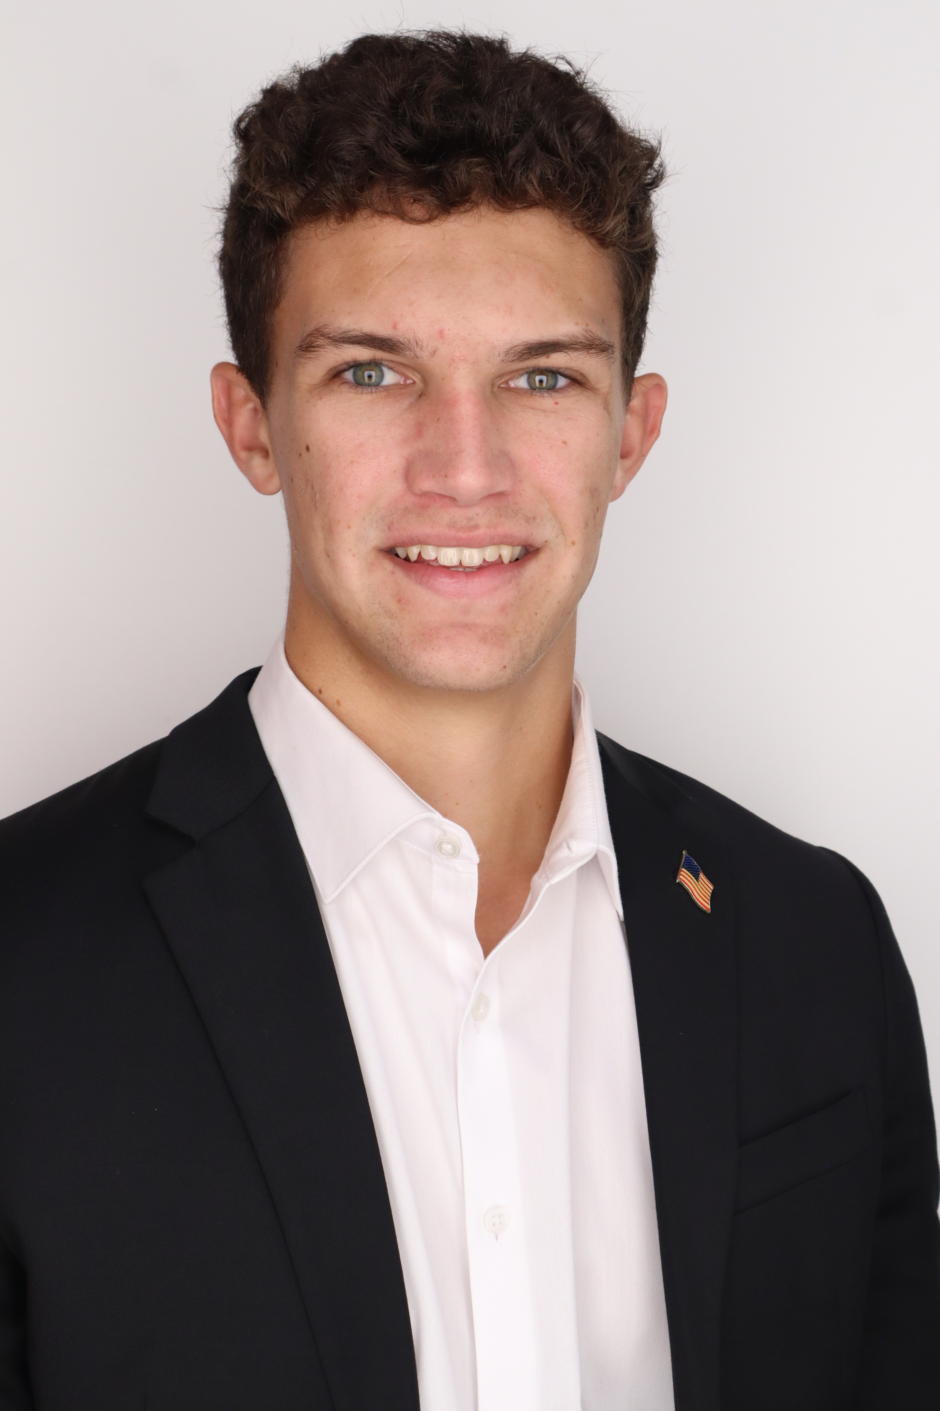
Introduction – Team 520
Natalie Boggess
John Baumann
Design Engineer
Cody Carlson
Software Engineer
Malik Jean-Baptiste
Robotics Engineer
Natalie Boggess
Marine Engineer
Megan Jadush
Materials Engineer
Anders Snell
Mechatronics
Engineer

Slide 4
Project Objective
Malik Jean-Baptiste
The objective of this project is to create a system capable of recording a diver’s position while submerged.

Slide 5
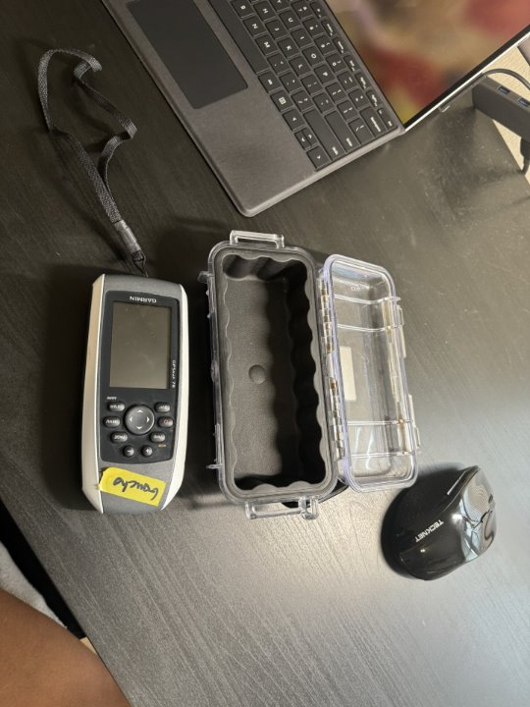
Project Summary
Malik Jean- Baptiste
Dr. Rassweiler SCUBA dives and plots diseased corals on his map
Current system: location is within a 5m radius circle (before standard error), wants to get more precise
Figure 1 : Current Equipment

Slide 6



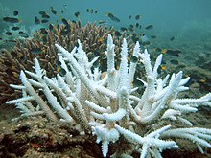




Overview
Malik Jean- Baptiste
GPS

Slide 7
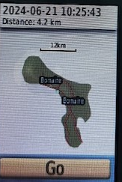
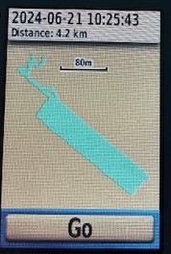
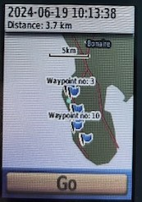
Overview
Malik Jean- Baptiste

Slide 8
Background
Malik Jean- Baptiste
GPS is incapable of penetrating through water
Relies on radio waves
Doppler Velocity System
Measures the velocity of the object in relation to the seafloor
Inertial Navigation System (INS)
Measures the acceleration of the object in relation to internal reference

Slide 9
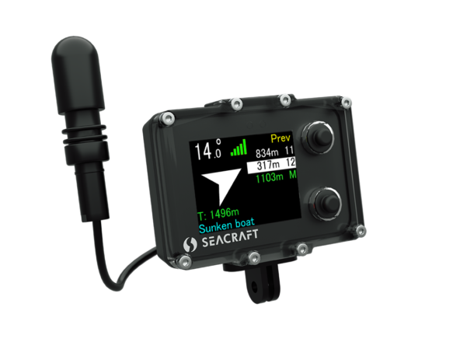
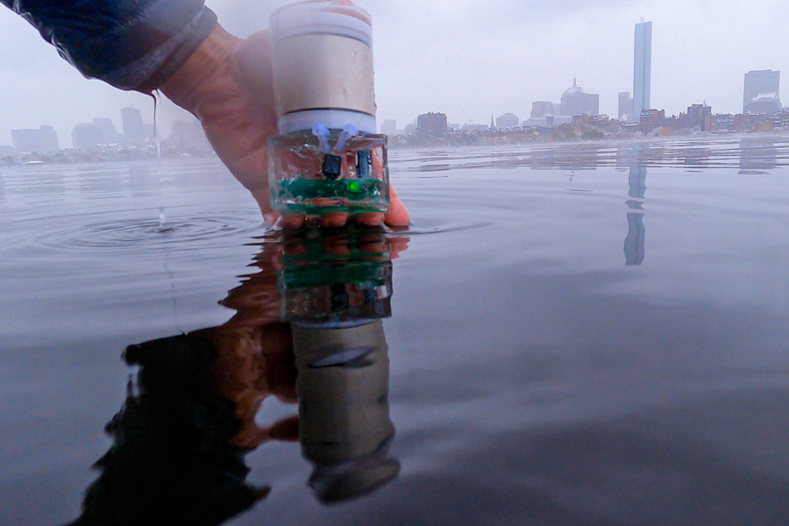
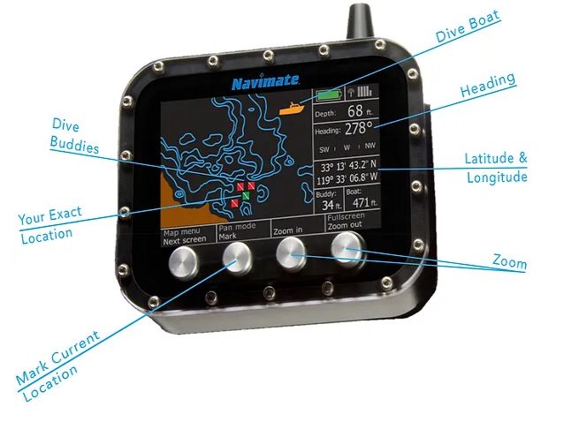
Current Technology
Malik Jean- Baptiste
Navimate UGPS [2]
ENC3-Pro [1]
Underwater Backscattered Localization [3]

Slide 10
Current Technology
Malik Jean- Baptiste
ENC3-PRO
Navigation Console
Underwater Backscatter Localization
Navimate UGPS
Uses Underwater Speed and Direction to calculate positioning
Used for topographic data and vertical orientation during the dive
Reflects modulated signals from the environment
Relays position data
Still in development
Uses a sensor hung from a surface system for short range communication
Calculates its own position independent of the position of the surface system

Slide 11
Doppler Velocity System
John Baumann
Doppler Velocity Log (DVL)
Attitude and Heading Reference System (AHRS)
Global Positioning System (GPS)
Velocity is calculated from the Doppler shift, measured using sonar
Orientation is determined with data from the DVL and a
magnetometer, ran through filter algorithms
Positioning data from satellites used to correct cumulative positional errors (drift) of the system

Slide 12
Inertial Navigation System (INS)
John Baumann
Inertial Measurement Unit (IMU)
Attitude and Heading Reference System (AHRS)
Global Positioning System (GPS)
Linear accelerations and angular velocities are measured with accelerometers and gyroscopes
Orientation is determined with data from the IMU and a
magnetometer, ran through filter algorithms
Positioning data from satellites used to correct cumulative positional errors (drift) of the system

Slide 13



Current Applications of INS
John Baumann
Subaquatic
Aviation
Space

Slide 14
Key Goals
John Baumann
The system will be able to reliably work at a depth underwater up to 8 meters.
The system will be accurate within 6-meters (including the 5-meter GPS public industry standard).
The system will be portable, capable of launching from the shore, and require minimal setup.

Slide 15


Primary Market
John Baumann
Dr. Rassweiler
Oceanographers

Slide 16



Secondary Market
Natalie Boggess
Commercial Fishing
Underwater Exploration
Recreational Divers

Slide 17


Secondary Market
Natalie Boggess
Recreational Fishing
Marine Sanctuary
Space Navigation

Slide 18




Assumptions
Natalie Boggess
The user will be within 10 meters of the water's surface.
The user has access to a watch and a waterproof notepad.
The max duration of each dive will be no longer than 90 minutes.
  Weather conditions will consist of wind (15-20 knots),
  small waves (2-3 feet), and a water temperature of around
  82°F.

Slide 19

Stakeholders
Natalie Boggess
Dr. Andrew Rassweiler
Investor, Decision Maker, Receiver
Rassweiler Laboratory
Operator
Dr. Shayne McConomy
Manager
Dr. Jonathan Clark
Expert
RL

Slide 20
Customer Needs
Natalie Boggess
Customer Statements
Interpreted Needs
I would consider it a success for the device to work as far down as 8-10m.
The device can operate with the user down to 10m.
The issue is that my current device leaves too large of a radius of where the sick coral is for me to plot its precise location.
The device can get a more precise reading of the diver’s location.
I want the device to fit in a carry-on bag.
The device can be packed into a carry-on bag.

Slide 21
Functional Decomposition
Natalie Boggess
Underwater Tracking System
Sensor
Power Source
Structures
Data

Slide 22
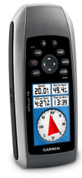
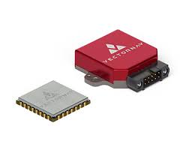
Future Work
Natalie Boggess
Order IMU
10/11/2024
Meet and discuss results with Dr. Rassweiler
10/31/2024
Continuous Research
Testing
10/25/2024
Further prototyping, augmentation, or purchases based on results
11/15/2024
VS
Figure 2: Inertial Measurement Unit [4]
Figure 3: Current Handheld GPS [5]

Slide 23
References
Natalie Boggess
[1] Tinssen. (n.d.). Underwater navigation systems: GPS for SCUBA divers. Seacraft. https://seacraft.eu/products/navigation-console/
[2] Navimate GPS for divers. navimate. (n.d.). https://www.navimate.com/
[3] Adib, F. (n.d.). An underwater navigation system powered by sound. MIT Media Lab. https://www.media.mit.edu/articles/an-underwater-navigation-system-powered-by-sound/
[4] What is an Inertial Measurement Unit? (2024). VectorNav. https://www.vectornav.com/resources/detail/what-is-an-inertial-measurement-unit
[5] Garmin GPSMAP 78 Handheld Navigator - 010-00864-00. (2024). Marine Electronics Shop. https://www.marine-electronics-shop.com/garmin-gpsmap-78-handheld-navigator-010-00864-00/

Slide 24
Recap
Natalie Boggess
Objective
Customer Needs
Current Technology Used

Slide 25
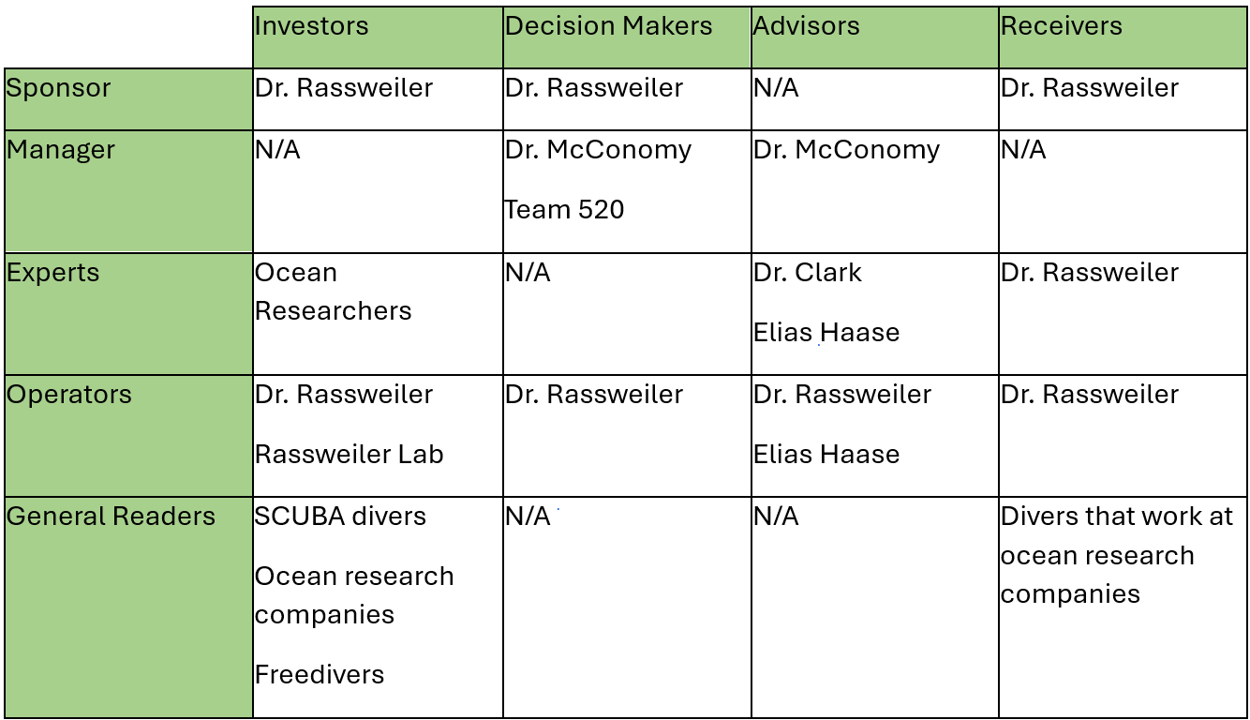
Stakeholder Matrix

Slide 26
Other Customer Needs
Customer Statements
Interpreted Needs
I go into the ocean from the shore.
The device is easy to carry straight from the shore into the ocean.
I need the device to be easy for me to use in the ocean, I don’t want to be carrying around a bunch of pieces.
The device consists of 1 or 2 small pieces.
It would never be longer than 90 minutes at a time.
The device’s battery lasts for at least 90 minutes.
The shore is very rocky and at some points clifflike.
The device is light and easy to maneuver.
The only extreme condition in the water is the wind, it is very windy.
The device still operates normally when experiencing high winds.
I have a good digital map of the area; my goal is to mark these locations onto my map to do analyses with them.
The device can log a digital location.

Slide 27
Critical Functions
Sensor
Power Source
Structures
Data
Tracks GPS Positioning
Tracks Diver Positioning
Tracks Time

Slide 28
Critical Functions
Sensor
Power Source
Structures
Data
Powers Underwater Device
Powers Data Transmission
Powers Potential Surface Device

Slide 29
Critical Functions
Sensor
Power Source
Structures
Data
Below Unit
Above Unit
Resisting Leaks
Resisiting Pressure Changes
Resisting Environmental Conditions
Endures Transportation
Resisting Temperature Changes

Slide 30
Critical Functions
Sensor
Power Source
Structures
Data
Data Transmission
Data Storage
Sends Diver Data
Receives Data From Diver
Stores System Information At Marked Times

Slide 31
Back Up Slides

Slide 32





Slide Headline
Try to keep text at 16 pt minimum.
Try to put as few words as possible on the slide if you’re using for a presentation.
Mix and match the backgrounds as shown in this template or just use one throughout.
You can put department/unit logos in slide master at Horizontal 0.89” Vertical 6.44” From top left corner

Slide 33
Font Check
This is 10-point
This is 15–point Times
This is 20–point
This is 25–point
This is 30–point
This is 35–point
This is 40–point
This is 50–point
This is 60–point
This is 72–point
Notes:
Use at least 20-point font in Room A105, B134, and B136
Use at least 25-point font in Room B135

Slide 34
College of Engineering Color Palette
1 2 3 4
Pantone: PMS 195 C
RGB: 120, 47, 64
Hex: #782F40
CMYK:19, 90, 50, 55
1 2 3 4
Pantone: Black C
RGB: 0, 0, 0
Hex: #000000
CMYK:0, 0, 0, 100
Garnet
Black
1 2 3 4
RGB: 238, 118, 36
Hex: #EE7624
CMYK:2, 66, 99, 0
1 2 3 4
Pantone: PMS 000C
RGB: 255, 255, 255
Hex: #FFFFFF
CMYK: 0, 0, 0, 0
Fang
Orange
White
Notes:
Avoid 75% Black in B135

Slide 35
Accent Color Palette
1 2 3 4
RGB: 0, 59, 111
Hex: #003B6F
CMYK:
1 2 3 4
RGB: 0, 59, 111
Hex: #003B6F
CMYK:
1 2 3 4
RGB: 251, 236, 93
Hex: #FBEC5D
CMYK:
1 2 3 4
RGB: 219, 215, 210
Hex: #DBD7D2
CMYK:
1 2 3 4
RGB: 251, 236, 93
Hex: #FBEC5D
CMYK:
1 2 3 4
RGB: 219, 215, 210
Hex: #DBD7D2
CMYK:
Tardis Blue
Tardis Blue
Corn
Timberwolf
Corn
Timberwolf
1 2 3 4
RGB: 206, 0, 88
Hex: #CE0058
CMYK: 0, 100, 43, 12
1 2 3 4
RGB: 206, 0, 88
Hex: #CE0058
CMYK: 0, 100, 43, 12
1 2 3 4
RGB: 104, 40, 96
Hex: #682860
CMYK:
1 2 3 4
RGB: 220, 220, 220
Hex: #DCDCDC
CMYK:
Rubine Red
Rubine Red
Imperial
Gainsboro
1 2 3 4
RGB: 72, 146, 155
Hex: #48929b
CMYK:
1 2 3 4
RGB: 64, 224, 208
Hex: #40E0D0
CMYK:
1 2 3 4
RGB: 255, 139, 0
Hex: #FF8B00
CMYK:
Asagi-iro
Turquoise
American Orange
Notes:
Remove American orange add hyperlink grey
Make corn the last for b135
All work in 134 imperial move later
Tardis doesn’t work in b136

Slide 36
F7AB19
D67F15
EE7624
D64615
F73119
Analogous
6E3610
F0A16C
EE7624
6E4931
BASB1C
Monochromatic
A14508
4BED3B
EE7624
250CED
2010A1
Triad
A1470C
FF8C40
EE7624
0098A1
24E2ED
Complementary
28A164
2FED8D
EE7624
0848A1
1871ED
Split Complementary
EDAC2F
3BED93
EE7624
0C6AED
ED2F18
Double Split Complementary
ED660C
C7ED3B
EE7624
0CE1ED
A418ED
Square
BA7E09
87724A
EE7624
60EFCF
09BA61
Compound
https://color.adobe.com/create/color-wheel
AD551A
6E3610
EE7624
FA7625
D46820
Shades
Notes:
These are the variants that work well with Fang Orange. The bolded items show well on the projectors.

Slide 37
85412D
8F3831
782f40
8F3176
792D85
Analogous
C44D69
8E626D
782F40
C48796
451B25
Monochromatic
C43959
78743B
782F40
236178
43A2C4
Triad
C43959
C46078
782F40
25C43D
2F783A
Complementary
93C460
577835
782F40
39C49D
297861
Split Complementary
784435
5A783B
782F40
237860
6E2978
Double Split Complementary
782337
78683b
782F40
237830
293978
Square
AB4D32
DEBAAF
782F40
5D8555
70AB32
Compound
https://color.adobe.com/create/color-wheel
38161E
C44D69
782F40
853447
5E2532
Shades

Slide 38
A105
A105
B135 Stage Left
B135 Stage Right
B136
B134, A105
B135

Slide 39
Border Line
Border Line
Border Line
Center of White Space
Center of Slide
Middle of Slide
Middle of White Space
Edge of Branding
Border Line
Notes:
Vertical lines from top down.
Borderline and top of title. (0.5 inch)
Center of Slide (0 inch y-direction for the entire slide)
Center of Design Content (0 inch y-direction considering the title, footer, and negative space)
Bottom of Design Content (0.25 in gap to the footer. 0.75 to the bottom of the screen)
Horizontal lines from left to right
Borderline (0.5 inch)
Center of design content.
Center of slide (0 inch y-direction for the entire slide)
Borderline (0.125 inch all around)

